Slide 1

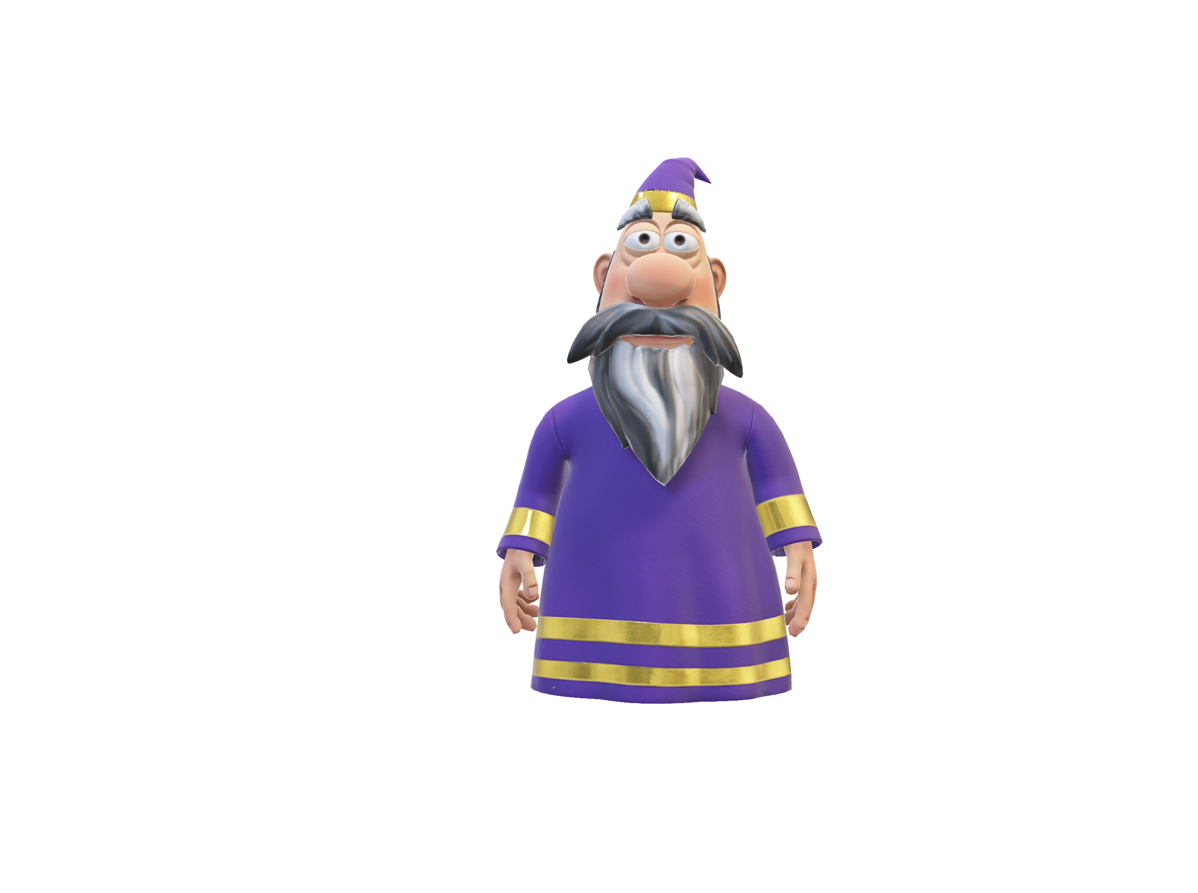

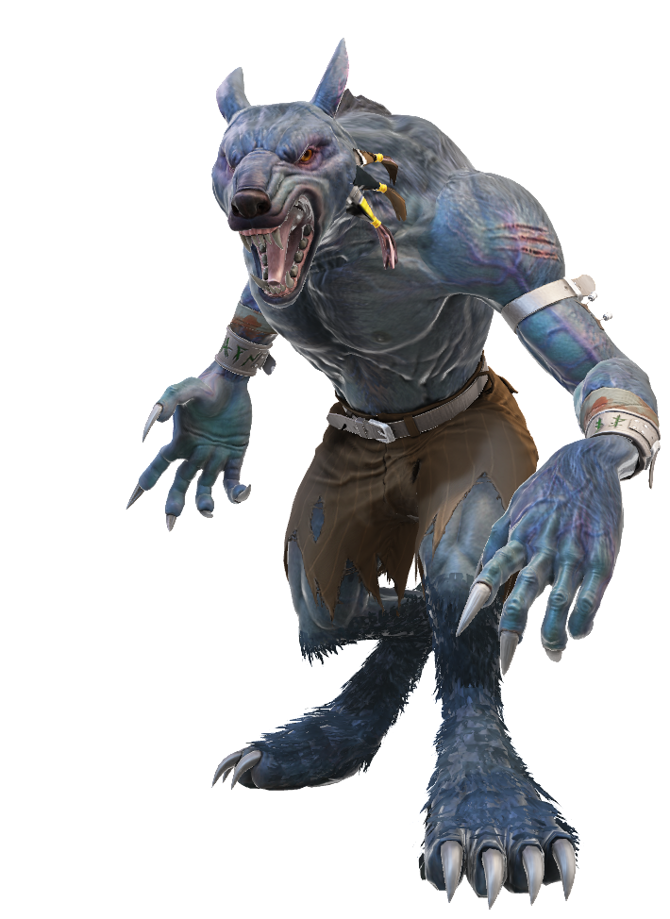
The quantum werewolf
By Ludovic Marcotte, Louis-Félix Vigneux, Wilhem Harvey and Rémy Lyscar
« compile moi si tu peux »
For the iQuCodeFest

Slide 2
The goal of the game
Two win conditions:
The Village (non-Werewolves players) killed all of the Werewolves.
The Werewolves compose more than half of the players alive.
Begin the game
Night Phase
Day phase

Slide 3



The core mechanics: How players can be killed ?
Player alife
Qubit representing a player’s state
Two phases:
The night phase
The day phase
Qubits represent the life of a player:
Player lives if state measured is
Player dies if state measured is
Player dead

Slide 4
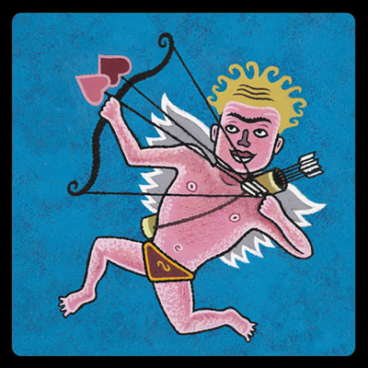

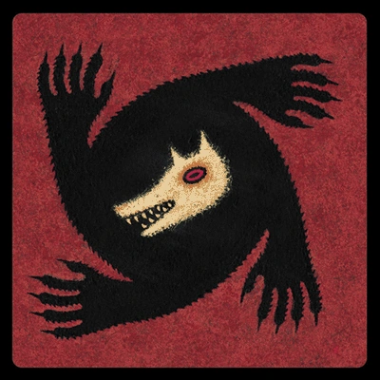


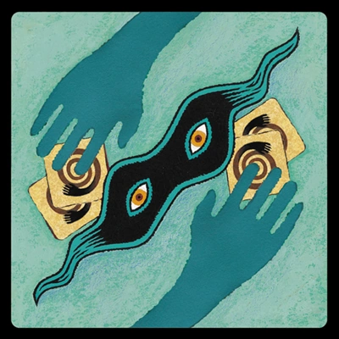
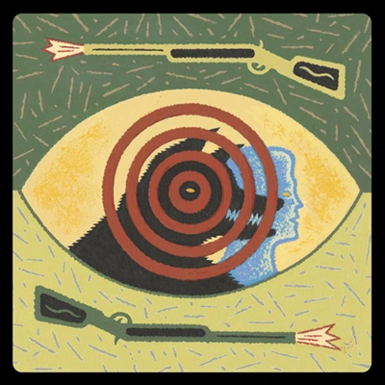



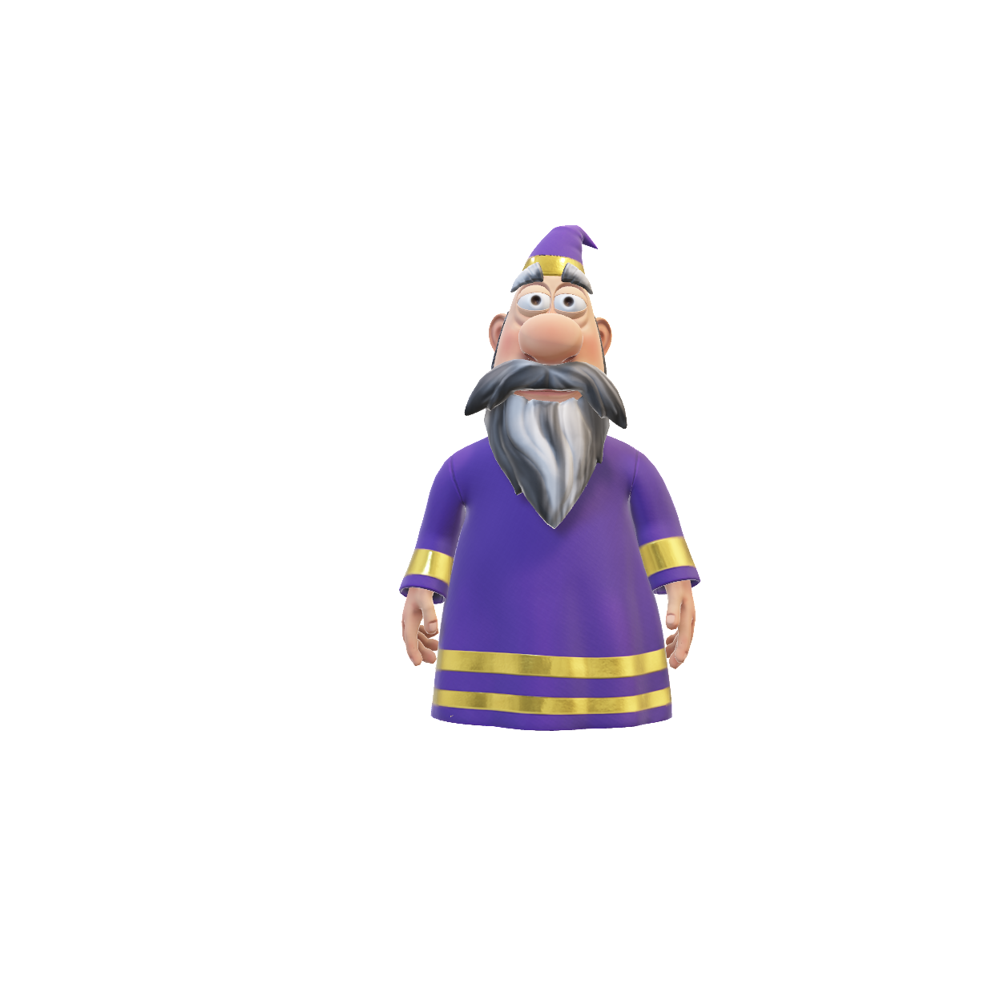
The roles
Order of the roles:
Cupid (1st turn only)
The Seer
The Werewolves
The Witch
The Saviour
The Thief
* Other roles:
The Hunter
The Captain
The Villagers

Slide 5
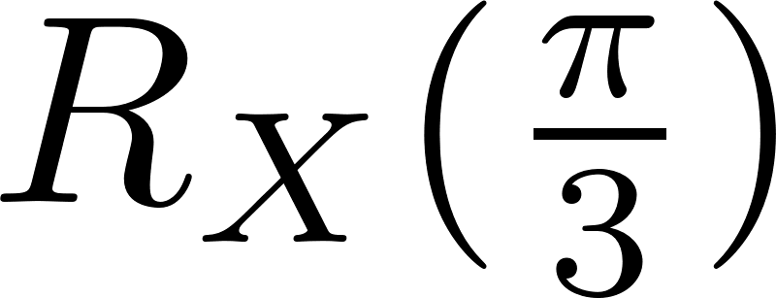
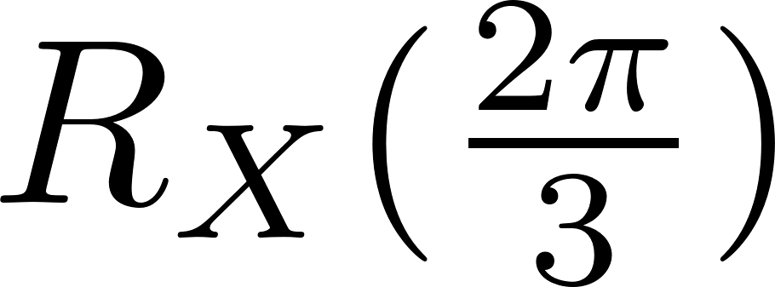
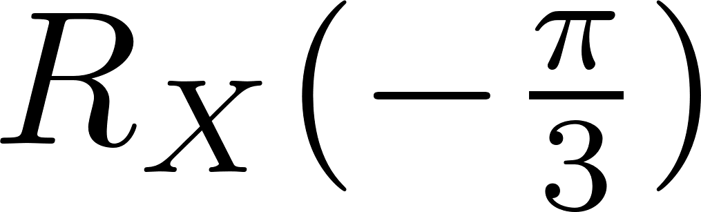
Explication of the quantum roles
Werewolves
Little attack gate
The Witch
Attack gate
Or
Little save gate

Slide 6
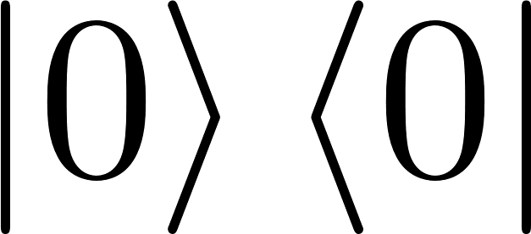
Explication of the quantum roles
Cupid
The Saviour
Entangle two players
Reset to

Slide 7
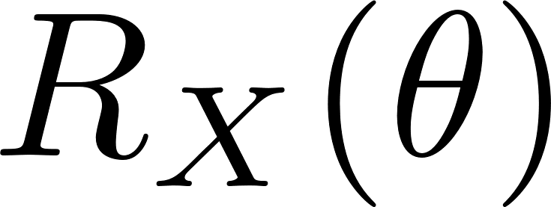
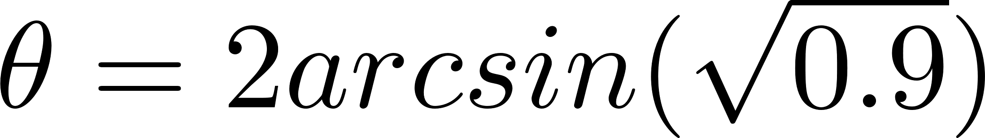
Explication of the quantum roles
The Hunter
The Thief
Big attack gate when
he dies
Swap gate
90% probability for the targeted player to die,
that is

Slide 8
Explication of the classical roles
The Captain
The Seek
The Villager

Slide 9
Explication of the night phase
Initiate a circuit for the players
Play all of the roles (append their gate)
Add the CNOT for the lovers

Slide 10
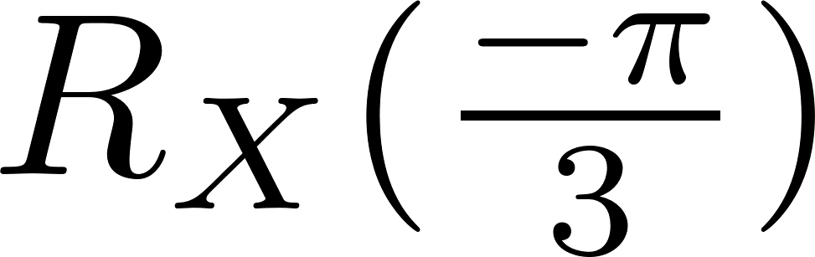
Explication of the night phase
Qubits are measured in the morning
in the Z-basis.
Gates are applied during the night phase.
Player 1 (role)
𝛼|0> + β|1>
Player 2 (role)
𝛼|0> + β|1>
|1>
Player 3 (role)
𝛼|0> + β|1>
Player 4 (role)
|0>
𝛼|0> + β|1>
…
...

Slide 11
Explication of the day phase
Measure the night circuit
Vote test
Hunter triggered?

Slide 12
The vote test: instant check to see if the player dies.
|0>
Voted player
or : lives or dies
|1>

